Slide 1
De Montfort Students’ Union
Annual Members Meeting May 2024

Slide 2
DSU Annual Student Members Meeting Recap
Discussed:
DSU Staffing Update; new CEO first year and Trustee Board structure
Updates from membership services
Financial reporting
Auditors findings
Affiliations

Slide 3
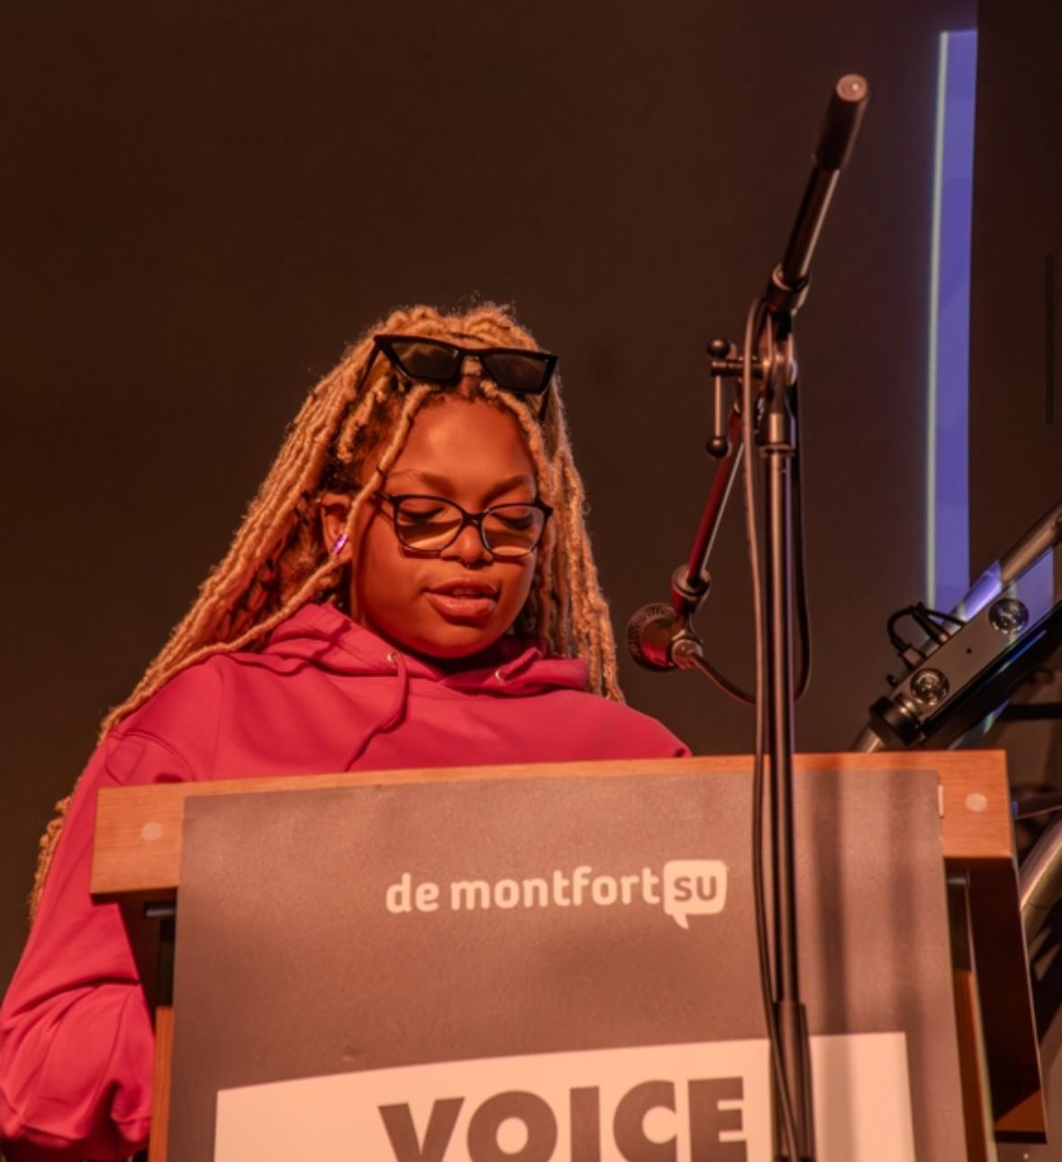
DSU Annual Student Members Meeting
Order of business
Apologies for Absence
Recap of the previous Annual Student Members’ Meeting
Report of the Trustees
Annual Accounts
Report of the Auditor
Affiliations
Any other Business (A.o.B.)

Slide 4
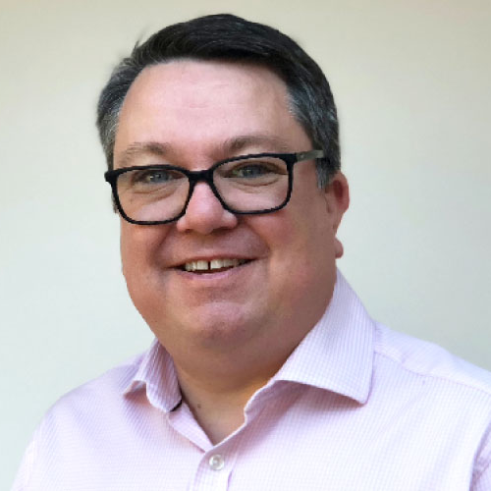
Geoff Kershaw, Chair
"DSU is a charity for students, and we take that role seriously as trustees.
We offer the CEO challenge, support and direction to achieve our strategic goals.
Your Trustee Board works for you, so please continue to feed back via Student Council so we can continue to meet your needs."

Slide 5
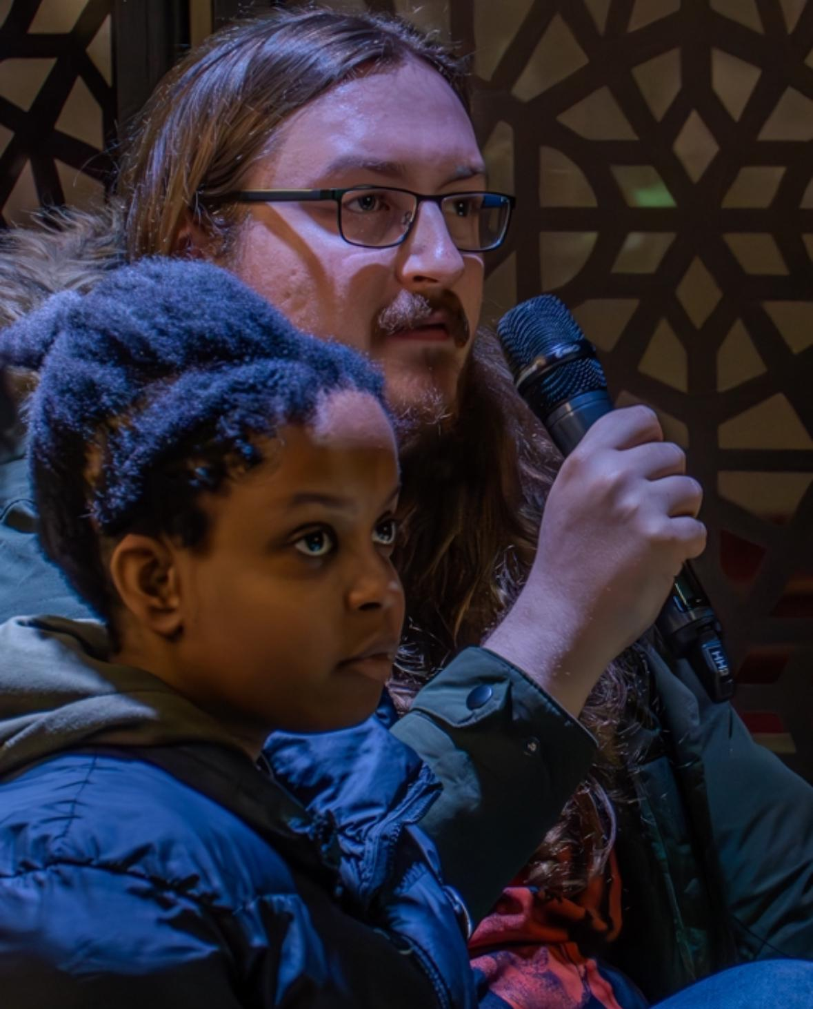
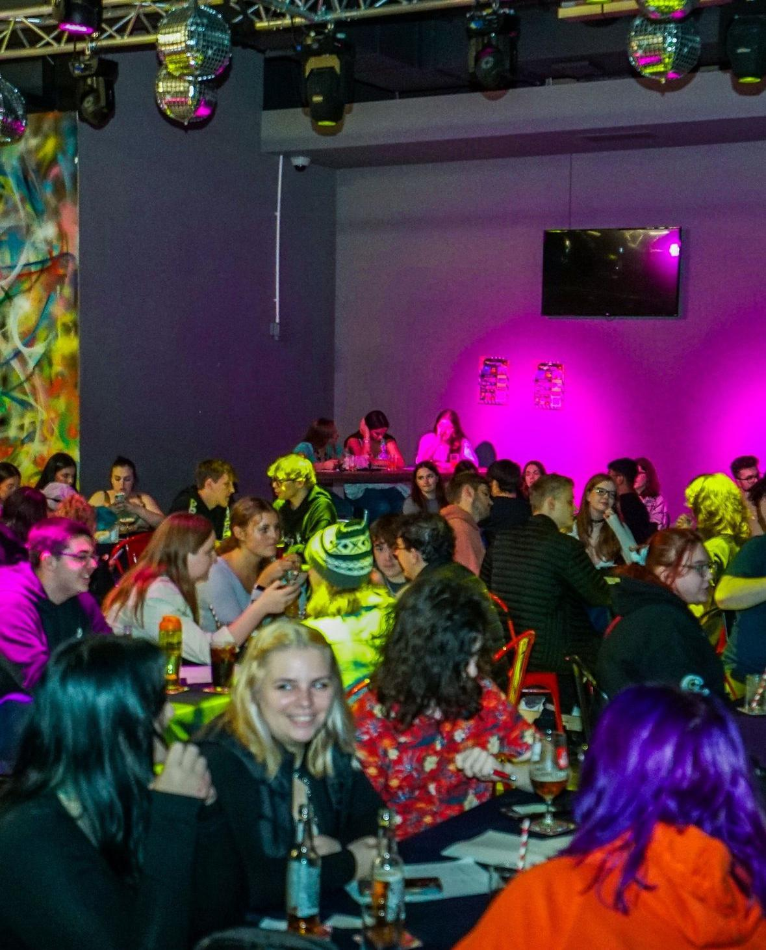
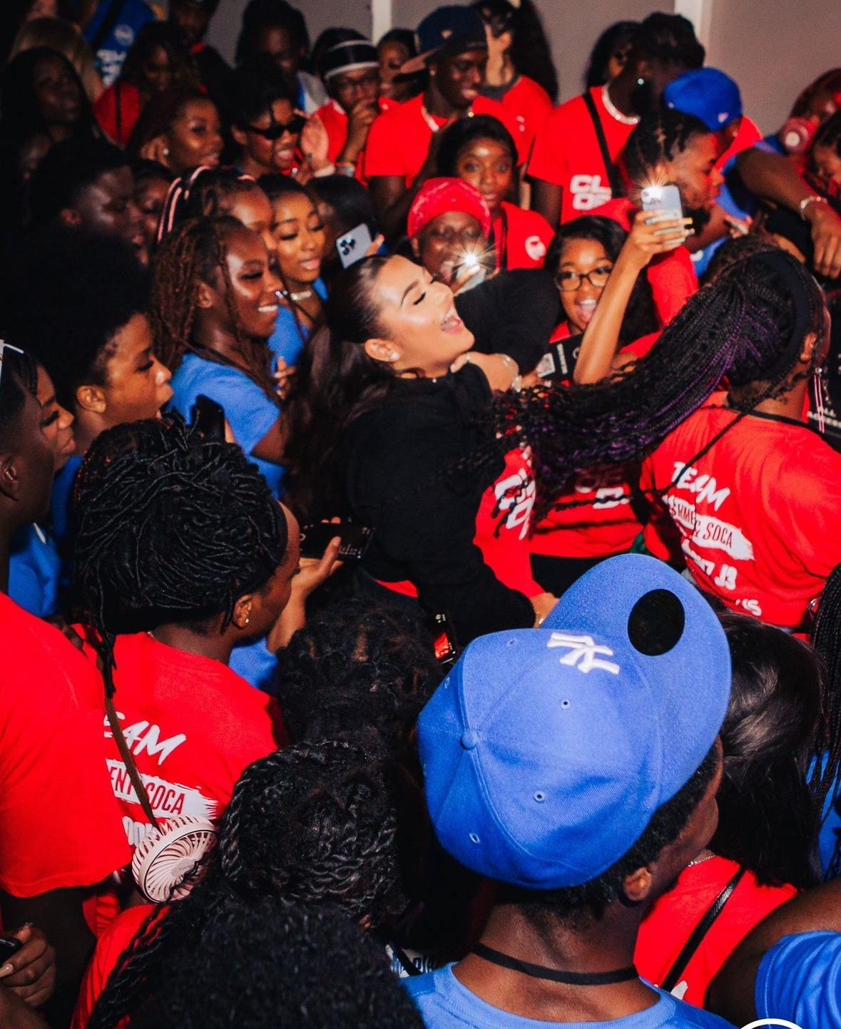
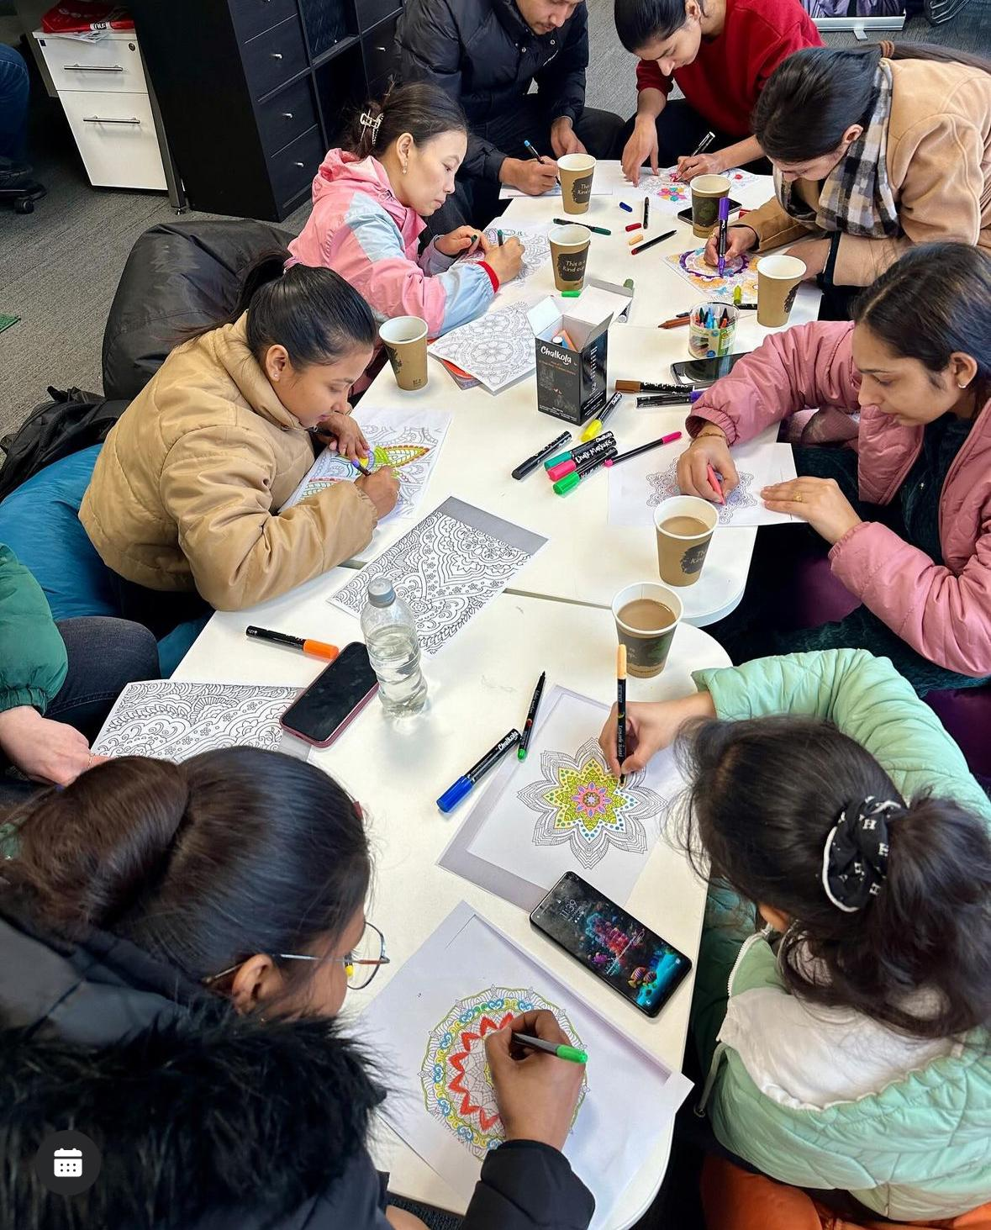
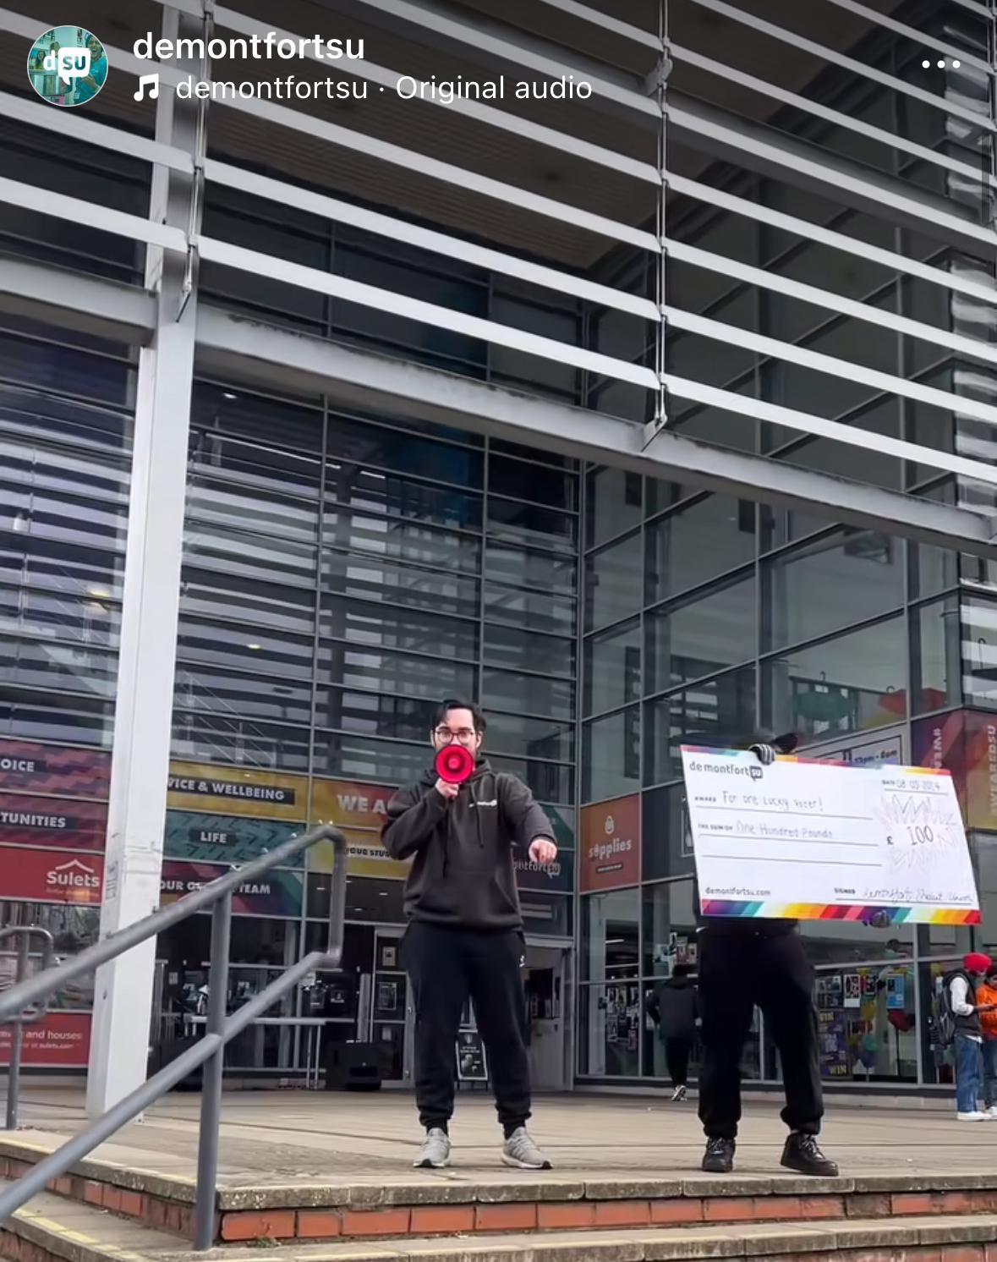
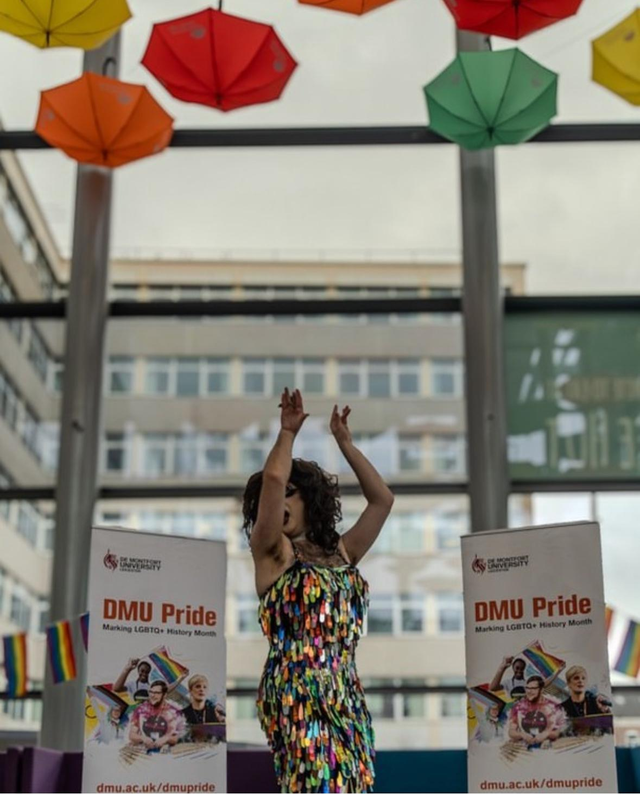
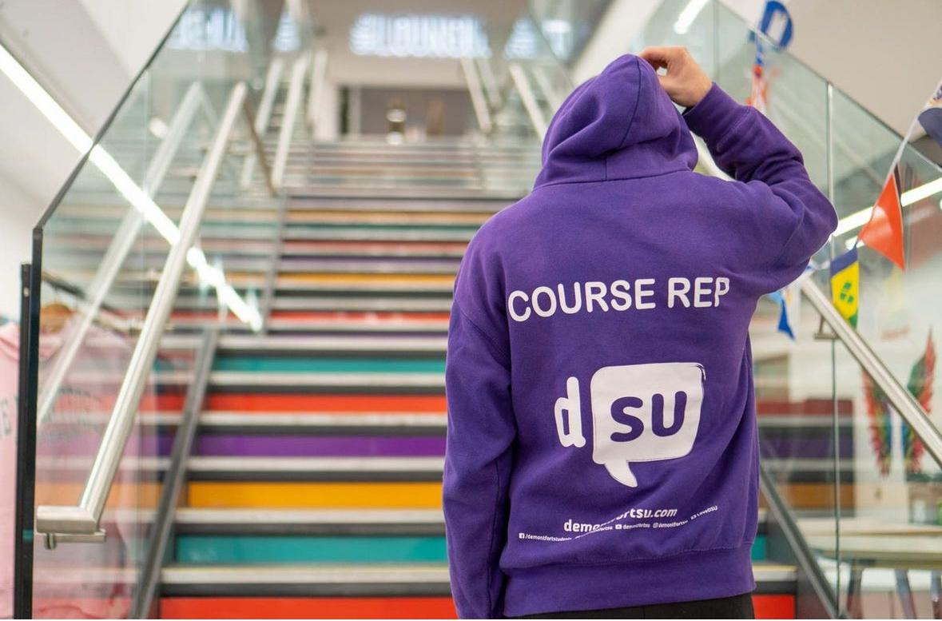
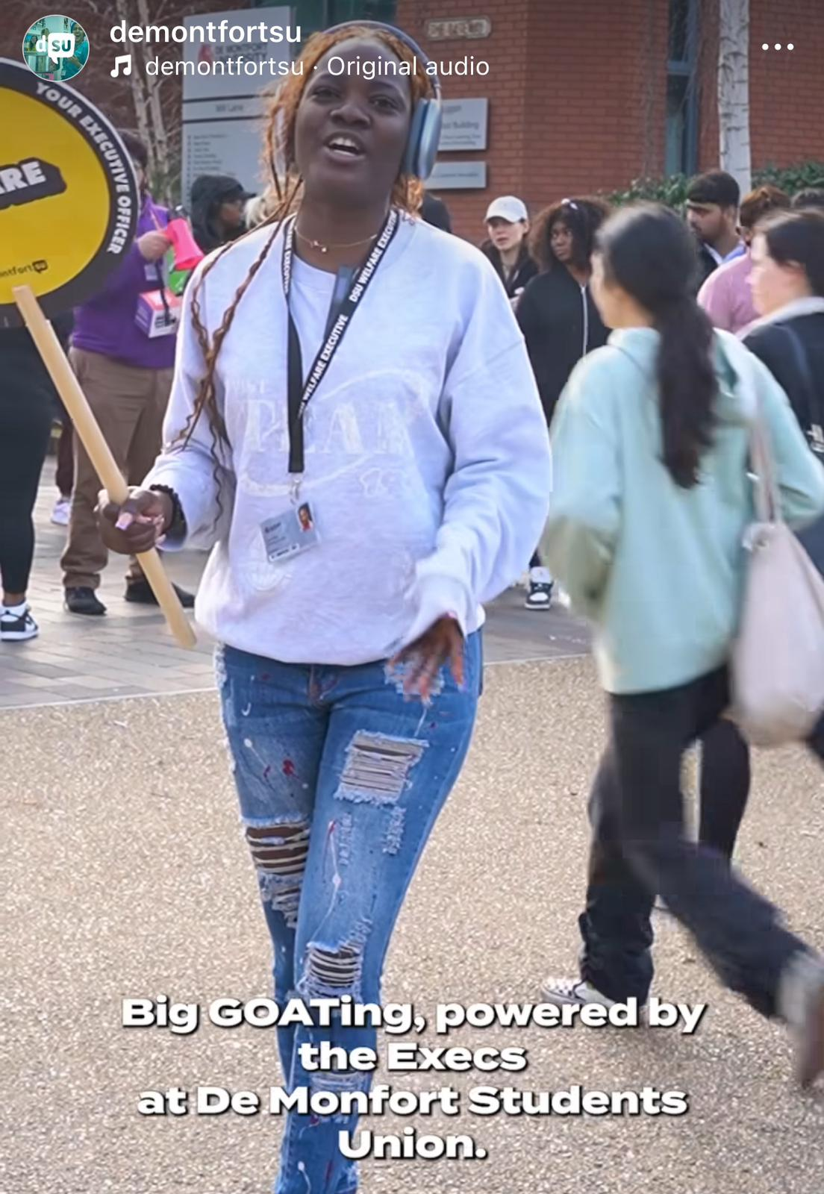
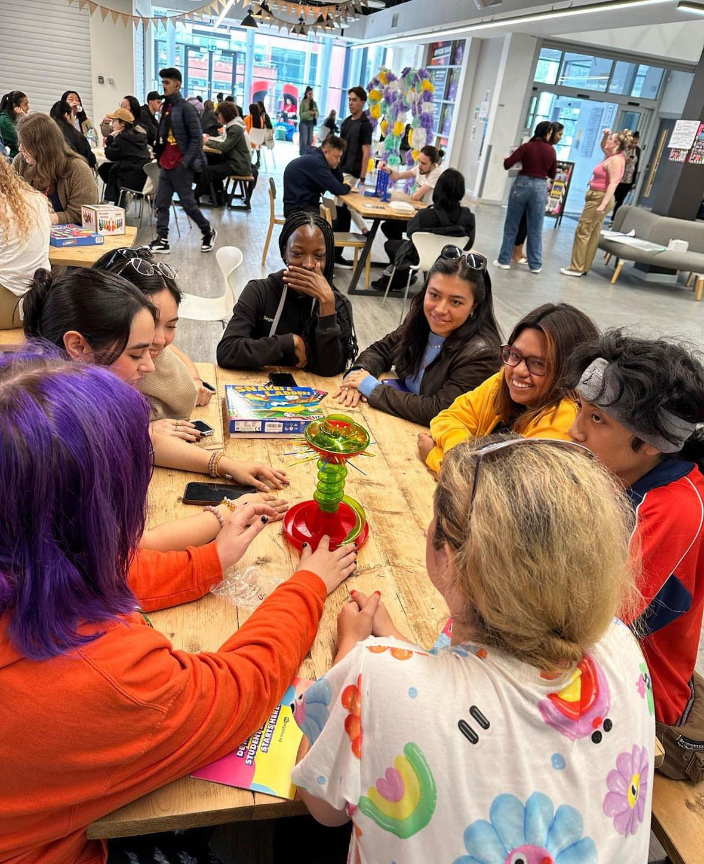
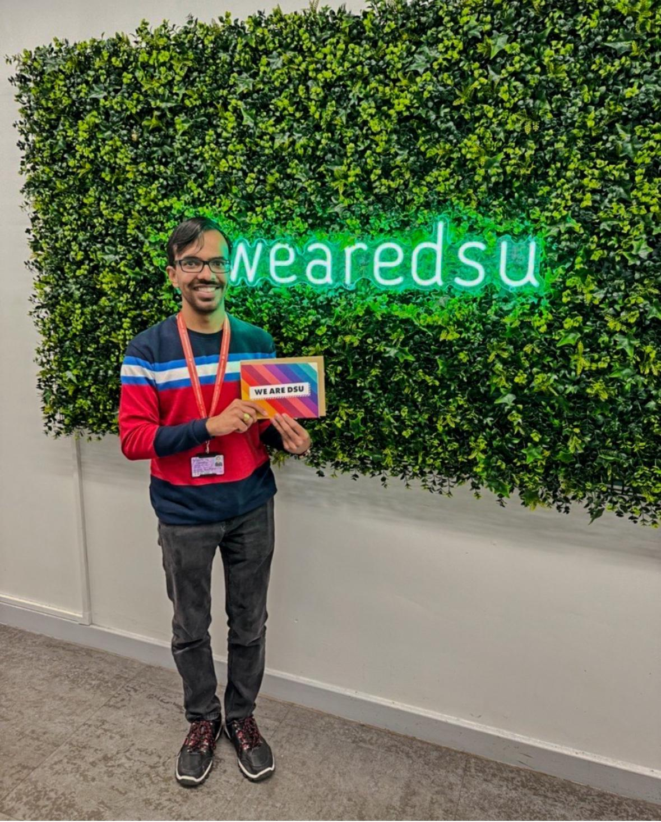
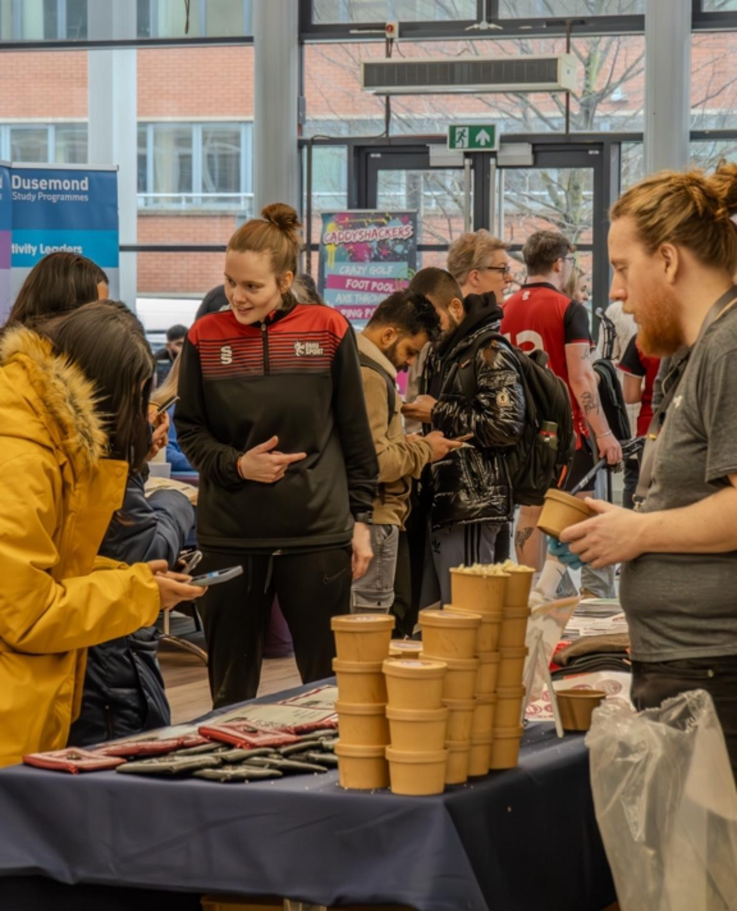
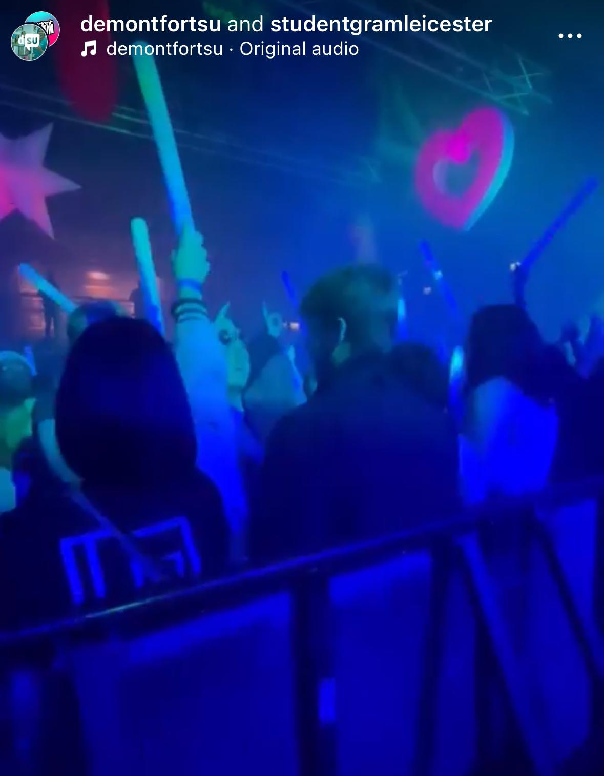
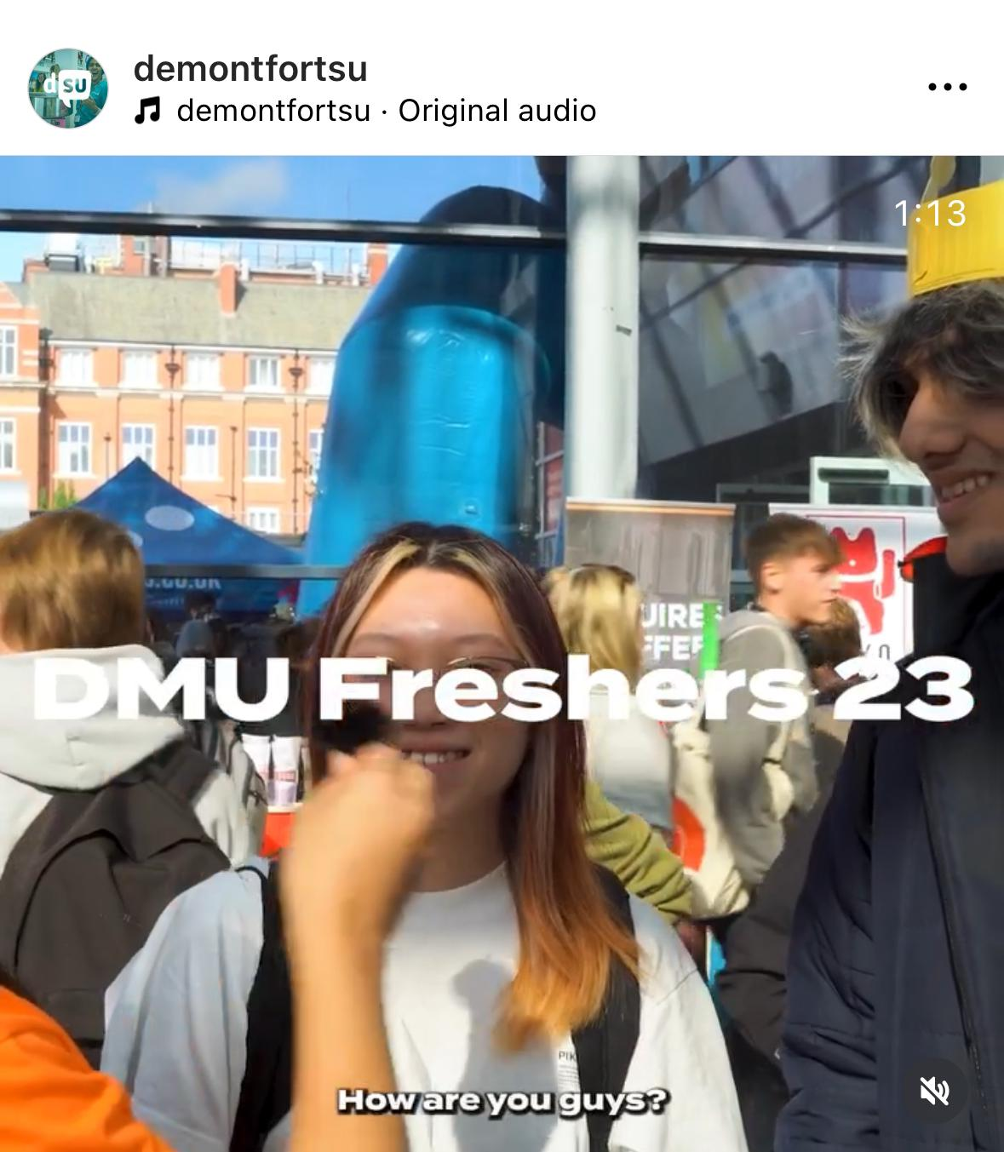
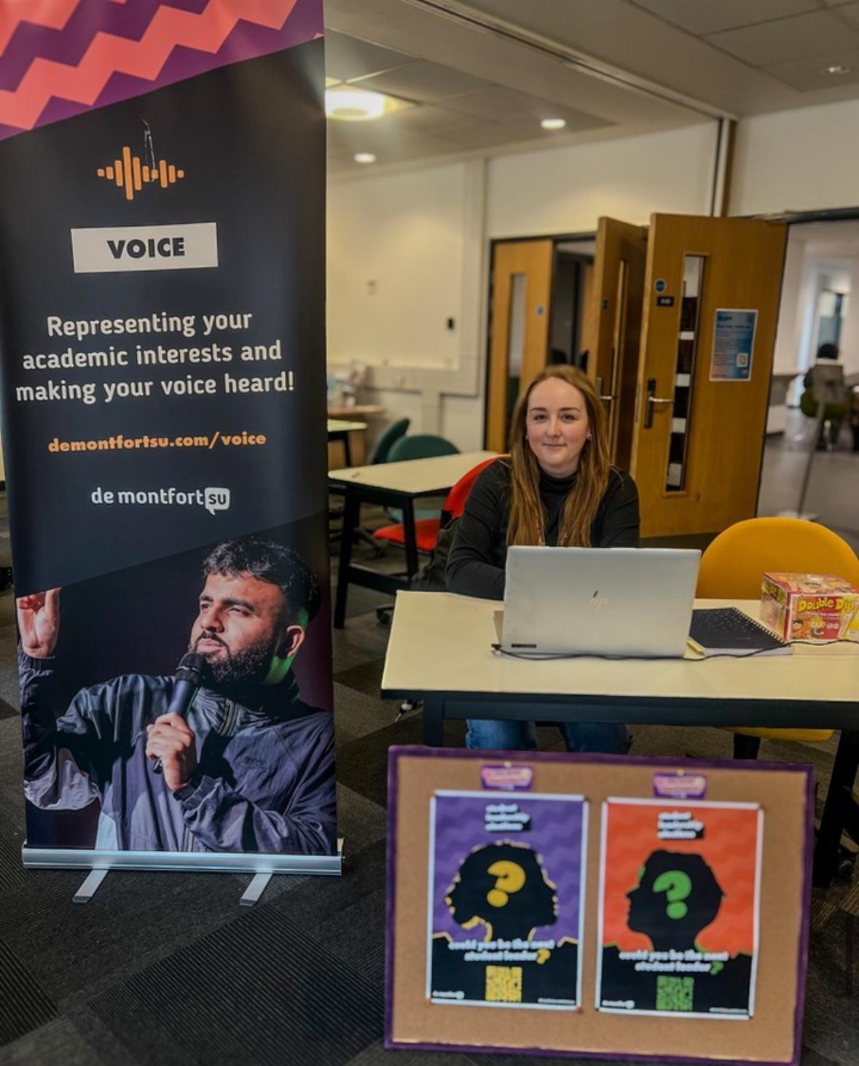
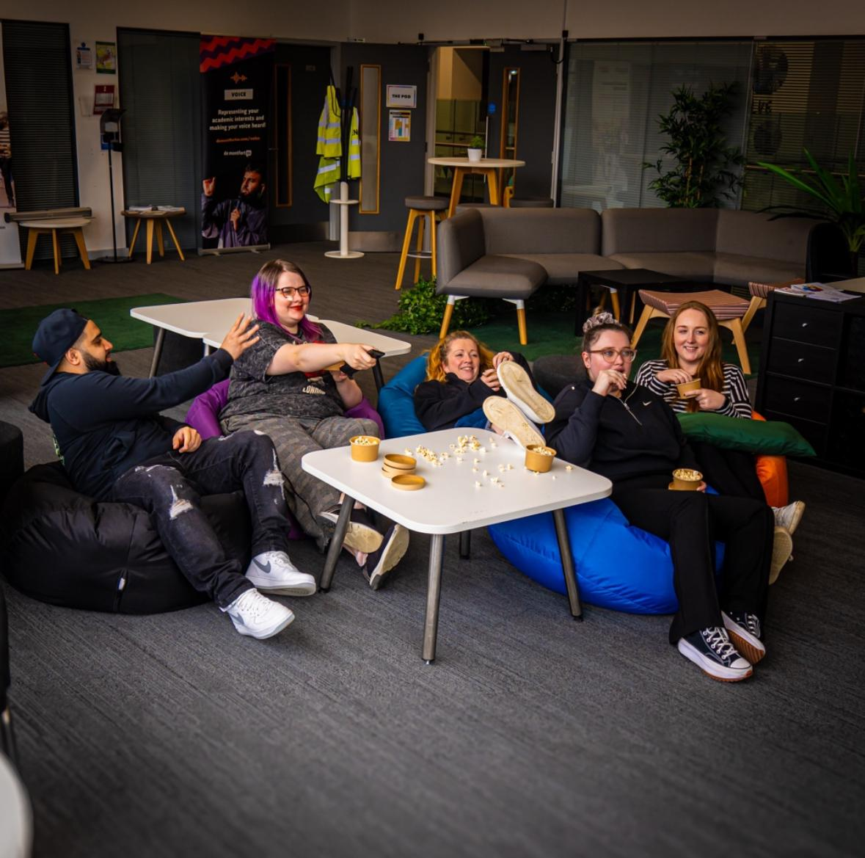
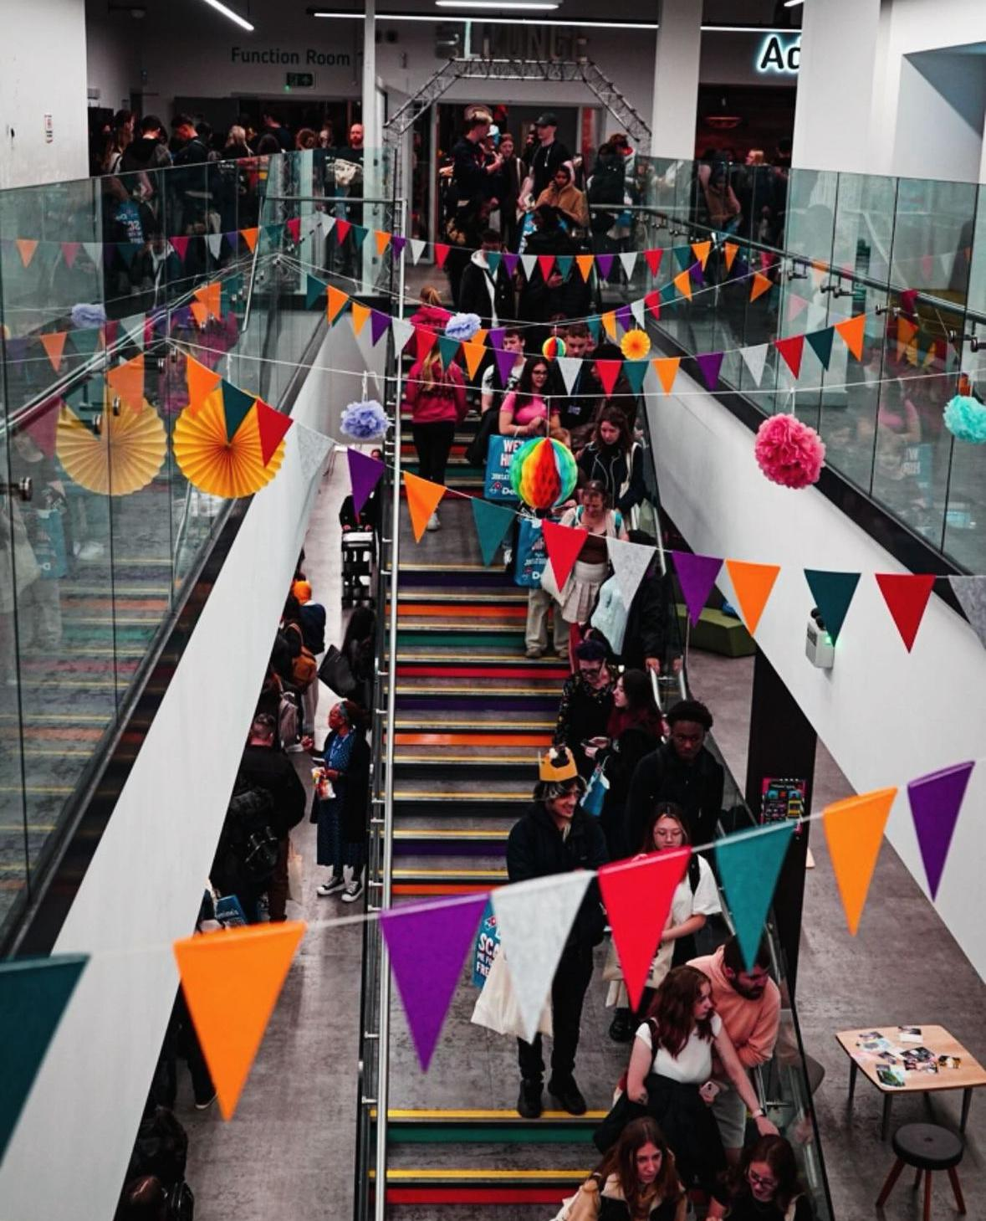
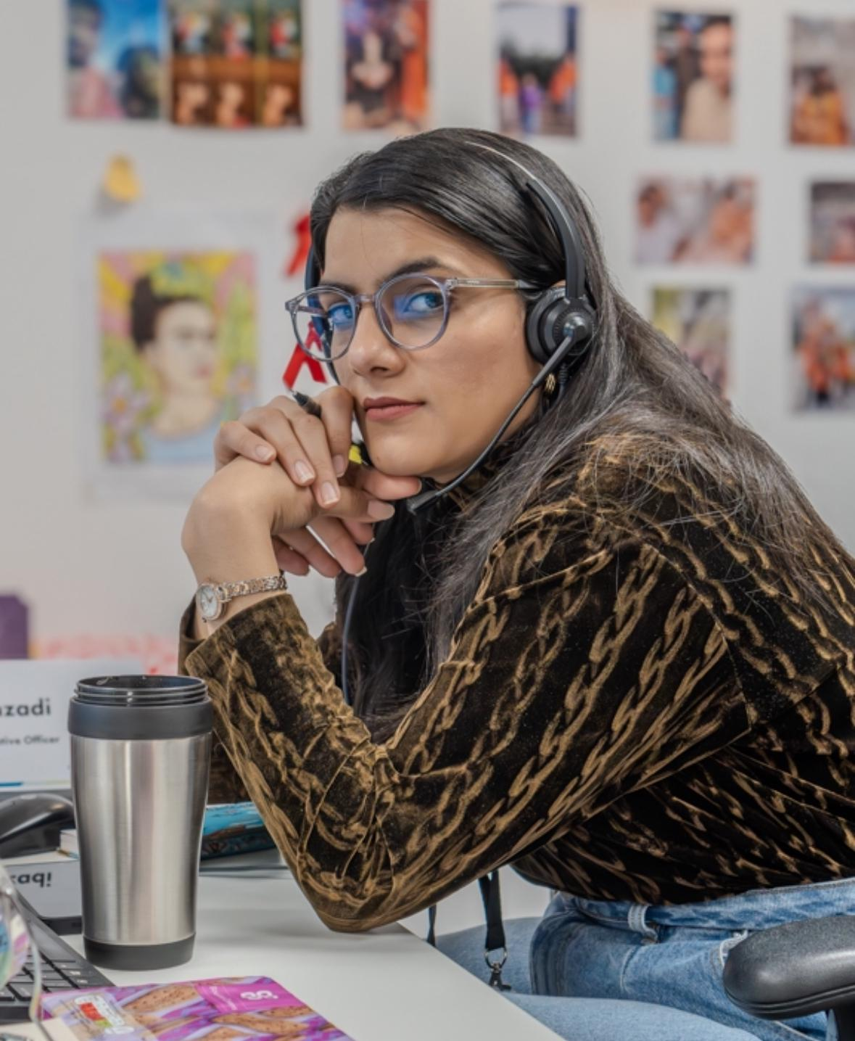
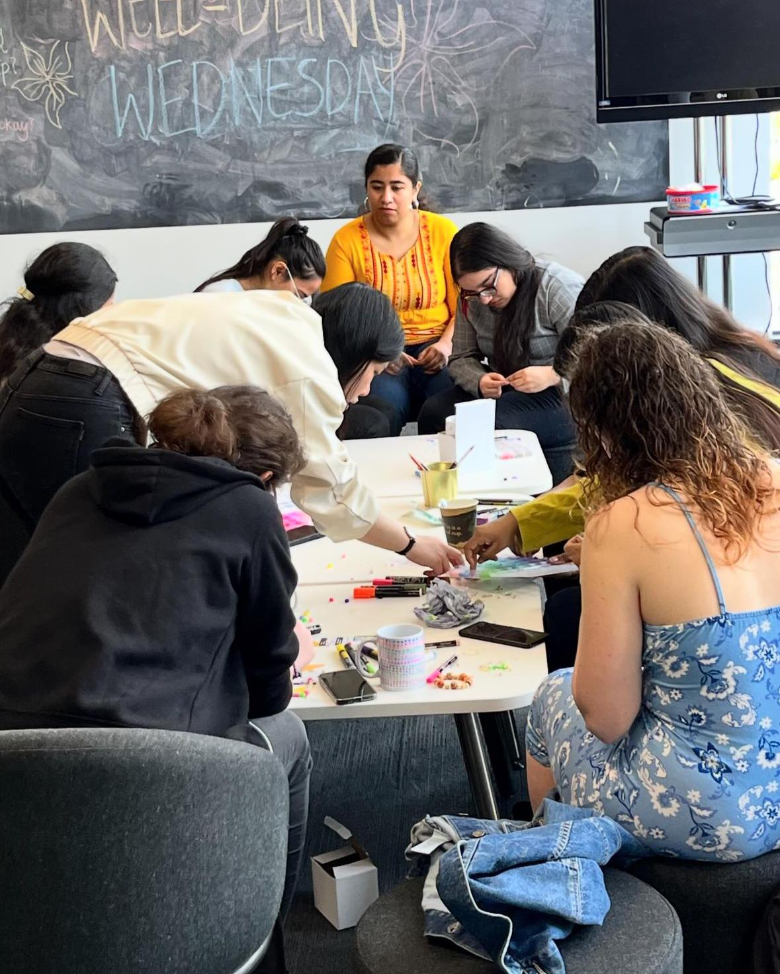

Slide 8
Key representation events
Freshers
Student Council & Scrutiny Panel
First Student Experience Action Group
Elections
Refreshers
NUS Conference
Sept
Oct
Nov
Jan
Feb
Apr

Slide 9
Liberation Officer achievements
Nerissa (Disabled Students Liberation Officer)
Accessible Campus Map, Destress Refresh Film Night
Judith (Postgraduate Students Liberation Officer)
Money Talks event, and Postgraduate Society established
Aria (Womens Liberation Officer)
Stitch and Bitch craft series and exhibition

Slide 10
Liberation Officer achievements
Toni (Mature Students Liberation Officer)
DMU Careers provision improvement action plan, Student Learning & Teaching Consultants project
Toni (Mature Students Liberation Officer)
DMU Careers provision improvement action plan, Student Learning & Teaching Consultants project
Toni (Mature Students Liberation Officer)
DMU Careers provision improvement action plan, Student Learning & Teaching Consultants project

Slide 11
Executive Officer achievements
International Students Experience
Enhanced Student Experience
CAS letter focus group, Friend Zone, Well-being walk, Cultural Belonging and Empowering.
Celebrating history months, Wellbeing sessions, SHAG week, Flea market, Lobbying for increased Academic support, Light the night
Visibility
GOATing, Social media, events, Increased Societies Engagements.

Slide 12
Independent Auditors Report on the financial statements
Properly Prepared
True & Fair View
Companies Act
Of the charity at 31/7/23 & of its incoming resources and application of resources
In accordance with UK Generally Accepted Accounting Practice
In accordance with the Companies Act 2006

Slide 13
Annual Accounts Income & Expenditure

Slide 14
DSU Affiliations 22/23
National Union of Students (NUS) - £30,926
WonkHE - £4330

Slide 15
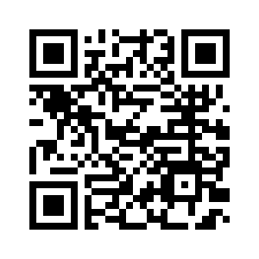
We need you!
We're seeking some amazing student trustees
Scan the code for more:

Slide 16
Any Other Business & Questions
Questions about Trustee Board membership
How our governance works and how we are governed
Affiliations
Officer updates or projects
Scrutiny panel reports
Motions and how to bring them
Areas of interest or concern for students
This meeting
Student Council

Slide 17
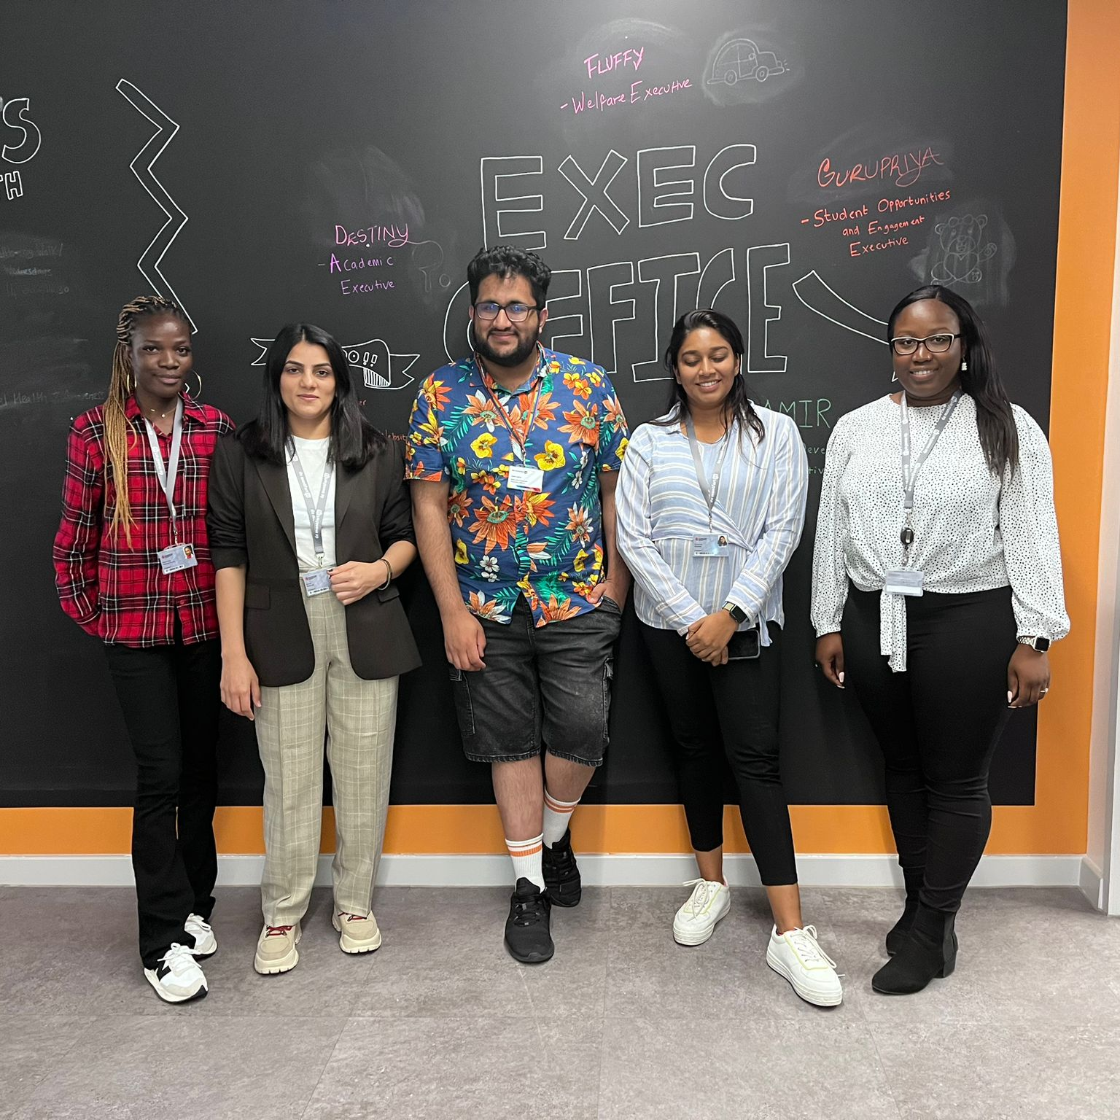
Student Council next
Thank you
Your Executive Officer Team & Trustees
2023-2024

